Slide 1
DEEP LEARNING • MEDICAL IMAGE ANALYSIS
14
Multi-Label Chest X-Ray
Disease Classification
Disease labels
CNN
EfficientNetV2B0, Transfer Learning, Fine-Tuning and Explainable AI
Automated feature learning
SHHORYA AGARWAL
2430010318
SECTION D
PROJECT PRESENTATION | 2026

Slide 2
PROJECT PRESENTATION
Abstract
• This project explores automated multi-label classification of chest X-ray images.
• The system learns to predict 14 disease labels for each image; multiple labels may be positive at the same time.
• A conventional CNN provides a baseline, while EfficientNetV2B0 uses pretrained image features.
• Transfer learning, selective fine-tuning and focal loss are investigated as approaches to improve learning.
• Model evaluation and explainability visualizations help analyse predictions and limitations.
• The system is an academic research prototype, not a clinical diagnostic device.
CHEST X-RAY CLASSIFICATION | ACADEMIC PROJECT
2

Slide 3
PROJECT PRESENTATION
Problem Statement
Clinical challenge
Technical challenge
Research challenge
Chest X-rays can show several conditions simultaneously. Reviewing images requires expertise and time.
Disease labels are imbalanced, visual patterns can be subtle, and model generalization is difficult.
A useful model needs evaluation beyond accuracy and should provide interpretable evidence for its predictions.
• Goal: investigate whether deep learning can predict multiple radiographic labels from one image.
• Focus: compare a baseline CNN with a pretrained EfficientNetV2B0 pipeline.
CHEST X-RAY CLASSIFICATION | ACADEMIC PROJECT
3

Slide 4
PROJECT PRESENTATION
Project Objectives
• Prepare and inspect the NIH ChestX-ray14 sample dataset.
• Convert disease annotations into a 14-column multi-label target matrix.
• Prevent patient overlap between training, validation and test splits.
• Train a baseline convolutional neural network.
• Apply transfer learning using pretrained EfficientNetV2B0.
• Fine-tune selected backbone layers using a lower learning rate.
• Investigate focal loss to address class imbalance.
• Evaluate the model and inspect explainability visualizations.
• Document limitations and opportunities for further research.
CHEST X-RAY CLASSIFICATION | ACADEMIC PROJECT
4

Slide 5
PROJECT PRESENTATION
Dataset: NIH ChestX-ray14 Sample
Images
Labels
Image size
Task
5,606 matched image records
14 disease categories
Original images reported as 1024 × 1024
Multi-label classification
• Metadata includes image filenames, findings and patient identifiers.
• Some images may have more than one positive disease label.
• The notebook uses a sample dataset rather than the full collection.
• The dataset includes a 'No Finding' annotation; this is represented by all 14 disease targets being zero.
CHEST X-RAY CLASSIFICATION | ACADEMIC PROJECT
5

Slide 6
PROJECT PRESENTATION
The 14 Target Disease Labels
Each output neuron estimates the probability of one finding.
01 Atelectasis
02 Cardiomegaly
03 Effusion
04 Infiltration
05 Mass
06 Nodule
07 Pneumonia
08 Pneumothorax
09 Consolidation
10 Edema
11 Emphysema
12 Fibrosis
13 Pleural Thickening
14 Hernia
CHEST X-RAY CLASSIFICATION | ACADEMIC PROJECT
6

Slide 7
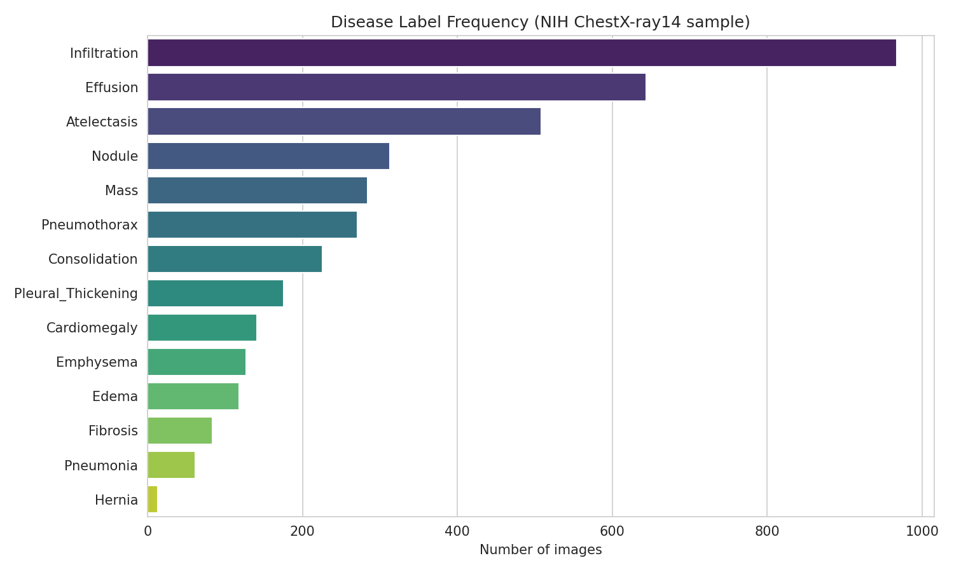
PROJECT PRESENTATION
Exploratory Data Analysis
• The notebook inspects dataset dimensions, patient counts, image dimensions and finding frequencies.
• In the recorded run, 5,606 images were matched to metadata.
• The recorded sample contains 4,230 unique patients.
• 3,044 images (54.3%) were annotated as 'No Finding'.
• Infiltration was the most frequent positive finding in the recorded sample.
• Hernia was extremely rare, illustrating the class-imbalance problem.
CHEST X-RAY CLASSIFICATION | ACADEMIC PROJECT
7

Slide 8
PROJECT PRESENTATION
End-to-End System Pipeline
01 Dataset
02 Cleaning
03 Splitting
Images + CSV annotations
→
Validate files and labels
→
Patient-level train/val/test
04 Preprocessing
05 Training
06 Evaluation
Resize to 224 × 224
→
CNN and EfficientNetV2B0
→
Metrics and visual analysis
Outputs: predicted label probabilities, evaluation summaries and explanation visualizations.
CHEST X-RAY CLASSIFICATION | ACADEMIC PROJECT
8

Slide 9
PROJECT PRESENTATION
Data Preparation and Preprocessing
• Automatically locate the metadata CSV and corresponding image files.
• Match each metadata record to its image path.
• Create one binary target column for each of the 14 diseases.
• Remove duplicate image records and check image readability.
• Resize images to 224 × 224 and convert them to three channels.
• Batch and prefetch data through TensorFlow's tf.data pipeline.
• Apply modest brightness, contrast, rotation, translation and zoom changes to training images only.
• Avoid horizontal flipping to preserve left-right anatomical orientation.
CHEST X-RAY CLASSIFICATION | ACADEMIC PROJECT
9

Slide 10
PROJECT PRESENTATION
Patient-Level Train / Validation / Test Split
Training
Validation
Testing
3,931 images
849 images
826 images
• The recorded run assigned patients to separate splits before sampling.
• Training data is used to fit model parameters.
• Validation data helps monitor performance and model selection.
• Test data is reserved for final evaluation.
• The notebook asserts that patient identifiers do not overlap across splits.
• This reduces the risk of overly optimistic results caused by images from the same patient appearing in multiple splits.
CHEST X-RAY CLASSIFICATION | ACADEMIC PROJECT
10

Slide 11
PROJECT PRESENTATION
Baseline Model: Convolutional Neural Network
• The baseline provides a reference point for the transfer-learning models.
• Three convolutional blocks use 32, 64 and 128 filters.
• Batch normalization and ReLU activation support feature learning.
• Max pooling reduces spatial dimensions; dropout helps regularization.
• Global average pooling feeds a 14-unit sigmoid output layer.
• Binary cross-entropy is used for the multi-label targets.
• The notebook trains the baseline for up to five epochs.
Recorded architecture
95,950 total parameters
CHEST X-RAY CLASSIFICATION | ACADEMIC PROJECT
11

Slide 12
PROJECT PRESENTATION
EfficientNetV2B0 Architecture
Pretrained backbone
Classification head
Output layer
ImageNet-pretrained EfficientNetV2B0 extracts image features.
Global average pooling, batch normalization and dropout.
14 sigmoid outputs, one for each disease label.
• The recorded architecture contains approximately 5.94 million parameters.
• Initially, the backbone is frozen while the classification head is trained.
• Pretrained weights provide a starting point rather than requiring all features to be learned from scratch.
CHEST X-RAY CLASSIFICATION | ACADEMIC PROJECT
12

Slide 13
PROJECT PRESENTATION
Stage 1: Transfer Learning
• Load EfficientNetV2B0 with pretrained ImageNet weights.
• Freeze the backbone to retain its pretrained feature representations.
• Train the new 14-label classification head on chest X-ray images.
• Use binary cross-entropy and multi-label AUC as the training objective and monitoring metric, respectively.
• Use early stopping, best-checkpoint saving and learning-rate reduction.
• The recorded training configuration allows up to six epochs.
Purpose
Adapt the classifier before updating backbone features.
CHEST X-RAY CLASSIFICATION | ACADEMIC PROJECT
13

Slide 14
PROJECT PRESENTATION
Stage 2: Fine-Tuning
• Unfreeze selected later layers of EfficientNetV2B0.
• Keep earlier layers frozen to preserve general low-level features.
• Keep batch-normalization layers frozen during backbone fine-tuning.
• Use a low learning rate with a cosine-decay schedule.
• Fine-tune the network to adapt higher-level features to radiographic patterns.
• Early stopping and checkpointing help retain a strong validation checkpoint.
Recorded configuration
Last 30% of backbone layers selected for unfreezing.
CHEST X-RAY CLASSIFICATION | ACADEMIC PROJECT
14

Slide 15
PROJECT PRESENTATION
Handling Class Imbalance with Focal Loss
• Disease frequencies differ substantially across the dataset.
• A model may favor common or negative labels while missing rare positive cases.
• Focal loss reduces the contribution of easy examples and emphasizes harder ones.
• The notebook creates an imbalance-aware model initialized from the fine-tuned model.
• The focal-loss model is trained with a separate low-learning-rate configuration.
• Its value must be established empirically using validation and test results.
CHEST X-RAY CLASSIFICATION | ACADEMIC PROJECT
15

Slide 16
PROJECT PRESENTATION
Evaluation: What the Metrics Mean
AUC
Precision
Recall
Measures ranking discrimination across thresholds.
Of predicted positives, the fraction that are truly positive.
Of actual positives, the fraction successfully detected.
F1-score
Binary cross-entropy
Confusion matrix
Harmonic mean of precision and recall.
Measures prediction error for binary labels.
Summarizes true/false positives and negatives per label.
For multi-label classification, metrics should be examined per disease and with clearly stated averaging and threshold choices.
CHEST X-RAY CLASSIFICATION | ACADEMIC PROJECT
16

Slide 17
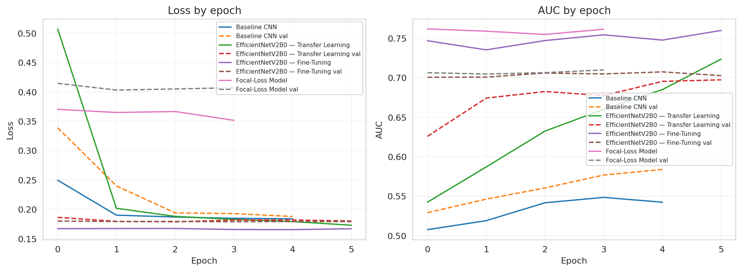
RESULTS AND VISUAL ANALYSIS
Training Curves: Loss and AUC
Solid and dashed lines distinguish training and validation curves. Inspect whether loss decreases, validation performance improves, and a widening train-validation gap suggests overfitting.
CHEST X-RAY CLASSIFICATION | ACADEMIC PROJECT
17

Slide 18
PROJECT PRESENTATION
Model Comparison: Recorded Validation AUC
Model | Best validation AUC | Epoch
Baseline CNN | 0.5837 | 5
EfficientNetV2B0 — Transfer Learning | 0.6973 | 6
EfficientNetV2B0 — Fine-Tuning | 0.7073 | 5
Focal-Loss Model | 0.7097 | 4
Extracted from the available in-memory training histories.
Validation AUC is not test-set performance and does not establish clinical readiness.
CHEST X-RAY CLASSIFICATION | ACADEMIC PROJECT
18

Slide 19
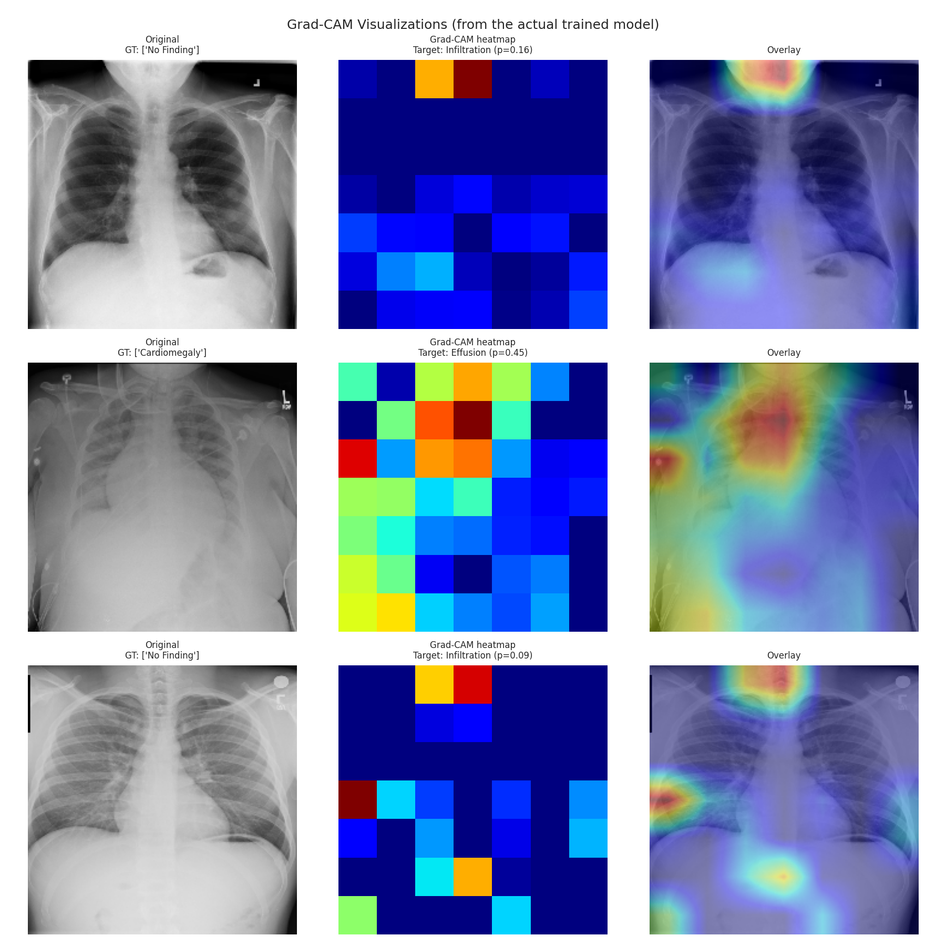
PROJECT PRESENTATION
Explainable AI: Understanding Predictions
Grad-CAM
Heatmap overlays
Interpretation
Highlights image regions that contribute to a selected model output.
Overlay the activation map on the original X-ray for visual inspection.
Check whether attention appears in plausible regions; explanations are not proof of clinical reasoning.
• Explainability helps make model behavior easier to inspect.
• Different diseases and images can produce different activation patterns.
• Heatmaps may also highlight irrelevant features or acquisition artifacts.
• A visually plausible heatmap does not guarantee a correct prediction.
• Only include explanation images actually generated by the notebook.
CHEST X-RAY CLASSIFICATION | ACADEMIC PROJECT
19

Slide 20
PROJECT PRESENTATION
How a Multi-Label Prediction Works
• Input: one chest X-ray image.
• The neural network extracts spatial and semantic features.
• The final sigmoid layer outputs 14 independent probabilities.
• A selected threshold converts probabilities into positive/negative labels.
• More than one disease label may be predicted for a single image.
• Thresholds affect the precision-recall trade-off and should be selected using validation data, not the test set.
CHEST X-RAY CLASSIFICATION | ACADEMIC PROJECT
20

Slide 21
PROJECT PRESENTATION
Limitations and Responsible Use
• The notebook uses a sample rather than the complete NIH dataset.
• Rare labels may have too few examples for reliable evaluation.
• Dataset annotations can contain uncertainty or noise.
• Performance on this dataset may not transfer to other hospitals or scanners.
• AUC alone does not capture all clinically relevant error types.
• Grad-CAM visualizations are approximate explanations, not causal evidence.
• The prototype is not intended for autonomous diagnosis or treatment decisions.
• External validation, expert review, calibration and prospective testing would be required before any clinical application.
CHEST X-RAY CLASSIFICATION | ACADEMIC PROJECT
21

Slide 22
PROJECT PRESENTATION
Conclusion and Key Takeaways
• Built a multi-label deep-learning pipeline for 14 chest X-ray findings.
• Used patient-level data separation to reduce leakage risk.
• Established a baseline CNN and investigated pretrained EfficientNetV2B0.
• Explored transfer learning, selective fine-tuning and focal loss.
• Used evaluation metrics and training curves to inspect model behavior.
• Added explainability as a way to visually audit selected predictions.
• Reliable medical AI requires more data, external validation and careful interpretation.
CHEST X-RAY CLASSIFICATION | ACADEMIC PROJECT
22

Slide 23
PROJECT PRESENTATION
Future Scope
• Evaluate the final model on a completely held-out test set.
• Report per-class precision, recall, F1, AUC and confidence intervals.
• Tune decision thresholds using validation data.
• Investigate calibrated probabilities and improved class-imbalance methods.
• Test on external datasets from different clinical settings.
• Evaluate explanation stability and possible shortcut learning.
• Consider subgroup performance and fairness analysis.
• Conduct expert-led review before considering any clinical workflow.
CHEST X-RAY CLASSIFICATION | ACADEMIC PROJECT
23

Slide 24
PROJECT PRESENTATION
References and Resources
• Wang et al. (2017). ChestX-ray8: Hospital-scale Chest X-ray Database and Benchmarks on Weakly-Supervised Classification and Localization of Common Thorax Diseases. CVPR.
• Tan and Le (2021). EfficientNetV2: Smaller Models and Faster Training. Proceedings of ICML.
• Selvaraju et al. (2017). Grad-CAM: Visual Explanations from Deep Networks via Gradient-Based Localization. ICCV.
• TensorFlow / Keras documentation: EfficientNetV2, image preprocessing, model training and evaluation.
• NIH ChestX-ray dataset metadata and the sample dataset used in this notebook.
• Project implementation, training histories and outputs from the Google Colab notebook.
Verify exact bibliographic details and dataset licensing before submission.
CHEST X-RAY CLASSIFICATION | ACADEMIC PROJECT
24

Slide 25
Thank You
Multi-Label Chest X-Ray Disease Classification

